Slide 1
Actuarial Report on Improvement of
Guarantee Products
SmallFund

Slide 2

Introduction
Background
Scope of problem
Assumptions
Outlines
01

Slide 3
Background
Recently, the fund managers in the financially well developed country A are allowed to sell products using options. SmallFund is a fund management organization in Country A, with the most popular of investments with guarantee.
However, the cost of capital has increased from 13% to 17% due to poor market outcomes, which means that the fees of guarantee products will increase, and may lead to reduction of investors for such products. So SmallFund is exploring the possibility of developing a guarantee product using options, by which both the option-based product and capital-based product will be optional for investors.

Slide 4
Scope of the problem
Compare an option-based product against a capital-based product and outline the benefits and drawbacks of the two products.
Put forward some suggestions when designing the two products.

Slide 5
Assumptions
Assumption I
Assumption II
The probability of capital backing of the capital-based products is 99%.
For simplification, we suppose that both the amount in the investors’ funds and the stock price is 1 at our starting time point T, i.e. we only invest in 1 unit of stock at time T.
Assumption III
Assumption IV
Since the term of the product is only three years, we do not take inflations into consideration.
After fitness of original data, we assume that the yield rates of equity are normally distributed, and the yield rates of bond and cash have a Weibull distribution to generate the investment return rate in the future.
Detailed discussion of Assumption IV, will be showed later in Part 2 ：Analysis of products.

Slide 6
Outlines
Analysis
Improvement
Comparison

Slide 7
Outlines: Analysis Part
As for the capital-based product
Simulate the annual return rate of equities, bonds and cash under Assumption III.
Calculate the three-year cumulative yield rate of stock.
Calculate capital required for filling the gap between actual stock return and guaranteed rate under each simulation.
Calculate its 99% quantile due to Assumption I.
Assume that all the capital is invested in bond, calculate product fee.
Figure out the final payout using difference between gross return (actual stock yield rate or guaranteed rate) and fee.

Slide 8
Outlines: Analysis Part
As for the option-based product
Given the strike price of 114.9369% (identical to the guaranteed rate), calculate the price of the European put option.
Calculate the product fee using the option price, the transaction cost and the target profit, then get the final payout from the difference between gross return and fee.

Slide 9
Outlines: Improvement & Comparison Part
In order to promote the capital-based product, we try different proportions of investment approach and identify the best portfolio that maximizes the final payout with certain accuracy. As for the option part, we change the strike price to either higher or lower to maximize the final payout and pick the appropriate strike price out.
According to the consequences from previous calculations, we list the corresponding fee, the amount of final payout and the volatility of the capital-based product under the best portfolio and the option-based product under the suitable strike price separately. Additionally, we give some analysis and further suggestions based on the comparing table.

Slide 10
Capital-based Product
Yield Rates Prediction
Capital-Based Product
Product Improvement
Comparison
02

Slide 11
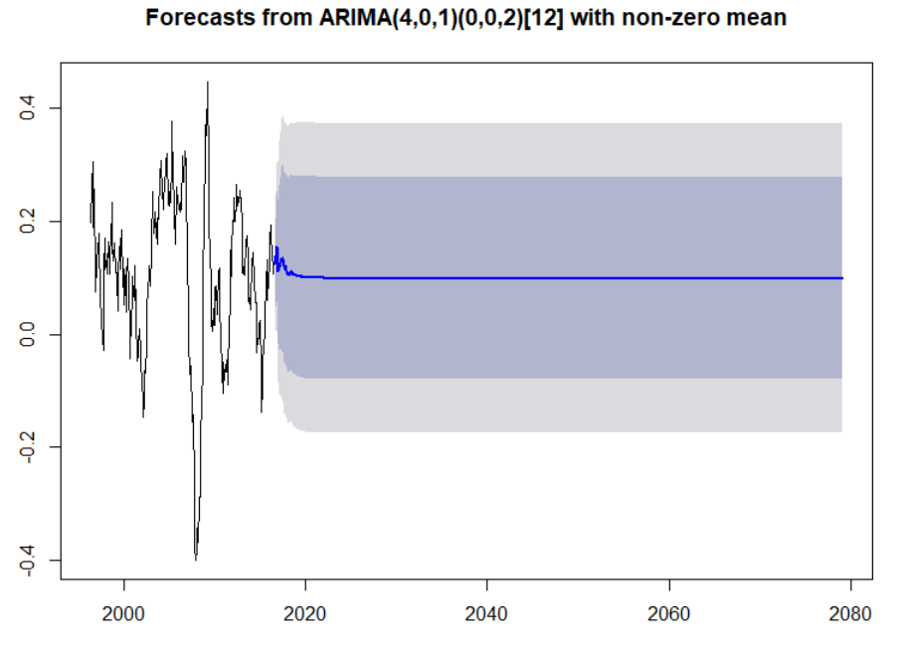
Yield Rates Prediction
We first use time series method to predict future investment return rates
Prediction of Equity Yield rate

Slide 12
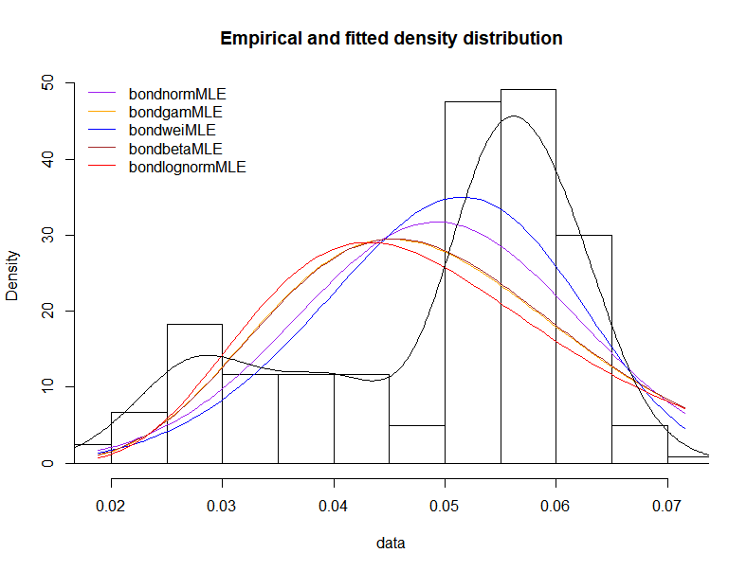
Yield Rates Prediction
Choose the data in recent 20 years to predict yield rates
BILL
Choose Weibull distribution to predict future bill yields by fitting with historical data.
BOND
Choose Weibull distribution to predict future bond yields by fitting with historical data.
EQUITY
Choose normal distribution to predict future equity yields by fitting with historical data.

Slide 13
Capital-Based Product
SIMULATION
Simulate yield rates of equity in 3 successive years by the fitted normal distribution .
PREDICTED RETURN RATE
Calculate the three-year cumulative rate of return.
EXPECTED RPI
CAPITAL BASED
With the RPI growth expectations, calculate three-year cumulative guaranteed rate of return ,which equals to 1.149369.
If the cumulative rate can not achieve the guaranteed rate of return ,the capital is the difference; Otherwise, the capital is zero.

Slide 14
Basic Capital-Based Product
Constraint condition
The cost of capital：17%
profit target：0.4%
Assumption
Assumption
all the capital is invested in bond
average yield rate：4.925458%
probability of capital backing：99%
Result
product fee：22.2591%
average payout：125.4494% of origin input

Slide 15
Product improvement
The average yield rates should be as high as possible.
The volatility of yield rates should be low enough.
select those whose probability of their yield rates being higher than the risk-free rate is the top 5%
find the portfolio with the highest average yield rates
a portfolio consists of 11.40% equity, 88.08% bond and 0.52% bill
average yield rate being 5.648578%
goal
strategy
Modified product

Slide 16
Comparison
Table 1 Comparison of The Basic and Modified Capital-Based Product
 | mean eq yield rates | guarantee rate | product fee | mean payout | sd payout
Basic capital-based product | 141.7144% | 114.9369% | 22.2591% | 125.4494% | 35.7690%
Modified capital-based product | 141.7144% | 114.9369% | 20.9229% | 126.7856% | 35.7690%

Slide 17
Option-based Product
Basic Product
Reduce Strike Price
Increase Strike Price
03

Slide 18
Basic Option-based Product
European put option(Black-Scholes model)
Exercise the option and get an amount of K
S_{T} < K:
S_{T} ≥ K:
Sell the stock share directly and get an amount of S_{T}, which is able to cover the guarantee return to your client.

Slide 19

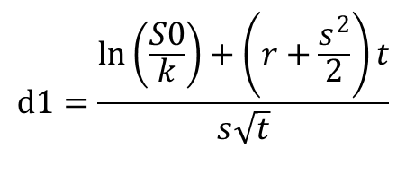
Strike price = Guarantee rate
When strike price = guarantee rate = 1.1494, the price of European put option(Black-Scholes model) P=13.8798%
additional transaction cost

Slide 20

Strike price = Guarantee rate
Annual fee
Annual fee is the fee in three years
Product fee
Final payout
10000 times simulation
Final payout = 130.8592%.

Slide 21
Product Improvement
Goals:
To reduce the product fee
To maximize the final payout of the product
Methods:
Increase strike price “K”, which means K＞guarantee rate G
Reduce strike price “K”, which means K＜guarantee rate G

Slide 22
Reduce Strike Price
final payout = guarantee - fee
ST
G
ST
K
ST
final payout = guarantee - fee
final payoff = ST - fee

Slide 23
Reduce Strike Price: product fee
Cost of capital to cover the gap of guarantee rate and actual stock yield rate
Cost of option trading, including the price of option and 0.15% transaction cost per trade
Profit target of SmallFund, which is 0.4% p.a.
TEXT HERE

Slide 24
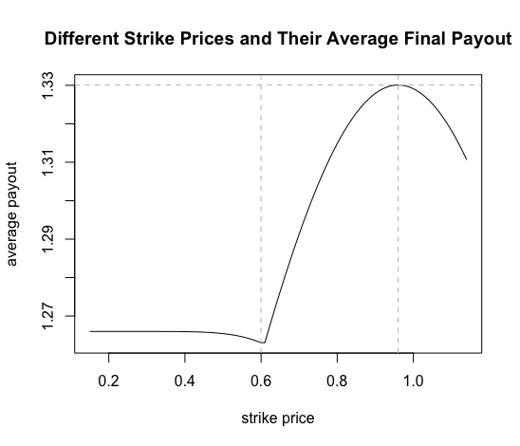
Reduce Strike Price
The figure shows the graph of different strike prices and their corresponding average final payout.
From it we can see that as the strike price K decreases, the average final payout first increase to the maximum, then decrease to the minimum, and slightly increase to a stable level.
The maximum and minimum values are obtained when K is about 0.96 and 0.6, respectively.

Slide 25
Reduce Strike Price
Table 2 Comparison of The Basic and Modified Option-Based Product
 | mean eq yield rates | guarantee rate | product fee | mean payout | sd payout
Basic option-based product | 141.7144% | 114.9369% | 16.8493% | 130.8592% | 35.7690%
Modified option-based product | 141.7144% | 114.9369% | 14.7005% | 133.0080% | 35.7690%
By reducing strike price, the product fee declines 2.1488% and the average final payout increases 2.1488% accordingly. This modified product promotes the profitability of option-based products significantly.
Obviously, there is a strike price that can maximize the average final payout.
→Therefore, we set strike price of the option being 0.96 to develop a better product.

Slide 26
Reduce Strike Price
The average final payout tends to be constant as the strike price is lower than 0.4.
Reason: when the strike price is low enough, the option price is close to zero and the cost of option trading equals to the transaction cost (0.15%).
The probability of exercising options is near zero, since stock price S_{T} are unlikely to be lower than strike price K. Capital is used to fill in the gap between S_{T} and G.

Slide 27
Reduce Strike Price: Examples
Table 3 Different Strike Prices and Their Comparison
strike price | option trading cost | product fee | average payout
15.00% | 0.1500% | 21.1090% | 126.5995%
25.00% | 0.1500% | 21.1090% | 126.5995%
35.00% | 0.1508% | 21.1100% | 126.5984%
45.00% | 0.1655% | 21.1282% | 126.5802%
65.00% | 0.6026% | 20.0751% | 127.6334%
75.00% | 1.4388% | 17.2820% | 130.4264%
85.00% | 3.0230% | 15.4295% | 132.2789%
95.00% | 5.5374% | 14.7068% | 133.0017%
105.00% | 9.0579% | 15.1907% | 132.5177%
114.00% | 13.0689% | 16.6446% | 131.0639%
→Notice that when the strike price is lower than 0.4, the average payout is 126.60%, which is close to 126.79% of the capital-based product.

Slide 28
Increase Strike Price
Payout=max{stock price , strike price}—option-based fee
（1）stock price(S)>strike price(K) no execution payout=S - fee
（2）strike price(K)>stock price(S) execution payout=K - fee

Slide 29
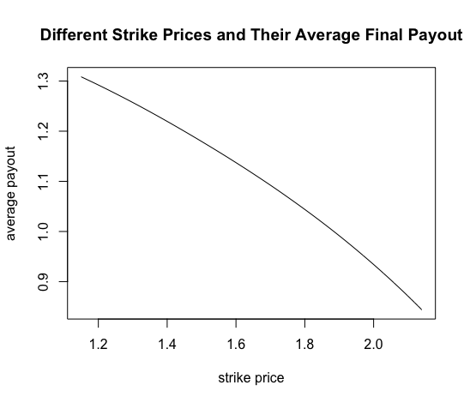
Increase Strike Price
1.15<K<2.14
Payout=max{stock price , strike price}—option-based fee

Slide 30
Comparison
Capital-based product
Option-based product
04

Slide 31
Comparison
Table 4 Comparison of Basic and Modified Products
 | mean eq yield rates | guarantee rate | product fee | mean payout | sd payout
Basic capital-based product | 141.71% | 114.94% | 22.26% | 125.45% | 35.77%
Modified capital-based product | 141.71% | 114.94% | 20.92% | 126.79% | 35.77%
Basic option-based product | 141.71% | 114.94% | 16.85% | 130.86% | 35.77%
Modified option-based product | 141.71% | 114.94% | 14.70% | 133.01% | 35.77%
The table tells us...
Option-based products have lower product fee and higher average payout compared to the capital-based products.
Standard deviation of payout of the two products is the same since the trend of stock price is identical in both cases.

Slide 32
Benefit
Comparison
Benefits of the option-based product are that put options can effectively ease the economic depression and maintain the stability of the investment market.
Risk
Some new risks may emerge from it, like moral hazard of default, even though it reduces the loss caused by market volatility. More specific types of risks, such as decreasing willingness to sell put options during depression, will be discussed in the Section 4 Risks and Uncertainties.
TEXT HERE
Disadvantage
The capital-based product has to take more risks from market fluctuations, but it also provides diversified investment choices, which is actually what the option-based product lacks.

Slide 33
Comparison
Therefore...
The modified option-based product, which is actually a combination of the option-based and capital-based products, has advantages of the two products, and is the most profitable choice for your organization.

Slide 34
Summary
Recommendations
Risks and Uncertainties
05

Slide 35
Recommendations
Investment strategy
If any product uses capitals when necessary, the capital should be invested in the portfolio consists of 11.40% equity, 88.08% bond and 0.52% bill, with average yield rate being 17.92095%, to ensure that the volatility of return is low enough and the average return rates is as high as possible.
Best Product
If you want to maximize the average payout to investors of these products, use the option-based product and set the strike price to be 0.96 is the best choice. The gap between actual stock yield rate and guarantee rate can be filled up by capital. The product fee is 14.40% and average payout to investors is 133.01%.
Further Improvement
If you want to further improve the product, you may need to consider other ways to reduce product fees, such as cutting down the cost of capital use or finding other financing methods with lower cost.

Slide 36
Risks and Uncertainties
Inflation
Since above analysis do no take inflation into consideration according to Assumption III, if inflation is getting extremely worse during the three years, the accuracy of our analysis may be influenced.
Economic Depression
Although options play an important role on guarantee of profitability during economic downturns, few people are willing to be the seller of put option in a recession and the option-based product will not work.
Emergencies
Emergencies, such as a natural disaster or war can cause devastating effects on a small country. Financial markets will be hit hard due to the scarcity of materials and the need for reconstruction, which lead to return of these product being great deviated from expectations.

Slide 37
THANK YOU
SmallFund

